Slide 1
What is Python?
Python is a popular programming language. It was created by Guido van Rossum, and released in 1991.
It is used for:
web development (server-side),
software development,
mathematics,
system scripting.
What can Python do?
Python can be used on a server to create web applications.
Python can be used alongside software to create workflows.
Python can connect to database systems. It can also read and modify files.
Python can be used to handle big data and perform complex mathematics.
Python can be used for rapid prototyping, or for production-ready software development.
Why Python?
Python works on different platforms (Windows, Mac, Linux, Raspberry Pi, etc).
Python has a simple syntax similar to the English language.
Python has syntax that allows developers to write programs with fewer lines than some other programming languages.
Python runs on an interpreter system, meaning that code can be executed as soon as it is written. This means that prototyping can be very quick.
Python can be treated in a procedural way, an object-oriented way or a functional way.

Slide 2
Python Programming
Python is an interpreted, object-oriented, high-level programming language with dynamic semantics. Its high-level built in data structures, combined with dynamic typing and dynamic binding, make it very attractive for Rapid Application Development, as well as for use as a scripting or glue language to connect existing components together. Python's simple, easy to learn syntax emphasizes readability and therefore reduces the cost of program maintenance. Python supports modules and packages, which encourages program modularity and code reuse. The Python interpreter and the extensive standard library are available in source or binary form without charge for all major platforms, and can be freely distributed.
Often, programmers fall in love with Python because of the increased productivity it provides. Since there is no compilation step, the edit-test-debug cycle is incredibly fast. Debugging Python programs is easy: a bug or bad input will never cause a segmentation fault. Instead, when the interpreter discovers an error, it raises an exception. When the program doesn't catch the exception, the interpreter prints a stack trace. A source level debugger allows inspection of local and global variables, evaluation of arbitrary expressions, setting breakpoints, stepping through the code a line at a time, and so on.

Slide 3
The debugger is written in Python itself, testifying to Python's introspective power. On the other hand, often the quickest way to debug a program is to add a few print statements to the source: the fast edit-test-debug cycle makes this simple approach very effective.
Python is a general purpose and high level programming language. You can use Python for developing desktop GUI applications, websites and web applications. Also, Python, as a high level programming language, allows you to focus on core functionality of the application by taking care of common programming tasks.

Slide 4
Comparing Python to Other Languages
Python is often compared to other interpreted languages such as Java, JavaScript, Perl, Tcl, or Smalltalk.
Java
Python programs are generally expected to run slower than Java programs, but they also take much less time to develop. Python programs are typically 3-5 times shorter than equivalent Java programs. This difference can be attributed to Python's built-in high-level data types and its dynamic typing. For example, a Python programmer wastes no time declaring the types of arguments or variables, and Python's powerful polymorphic list and dictionary types, for which rich syntactic support is built straight into the language, find a use in almost every Python program. Because of the run-time typing, Python's run time must work harder than Java's. For example, when evaluating the expression a+b, it must first inspect the objects a and b to find out their type, which is not known at compile time. It then invokes the appropriate addition operation, which may be an overloaded user-defined method. Java, on the other hand, can perform an efficient integer or floating point addition, but requires variable declarations for
a and b, and does not allow overloading of the + operator for instances of user-defined classes.

Slide 5
For these reasons, Python is much better suited as a "glue" language, while Java is better characterized as a low-level implementation language. In fact, the two together make an excellent combination. Components can be developed in Java and combined to form applications in Python; Python can also be used to prototype components until their design can be "hardened" in a Java implementation. To support this type of development, a Python implementation written in Java is under development, which allows calling Python code from Java and vice versa. In this implementation, Python source code is translated to Java bytecode (with help from a run-time library to support Python's dynamic semantics).

Slide 6
Flavors of Python
CPython
This is the most widely accepted implementation of Python. It is written in the language C, and is an interpreter. The base of all these implementation is Cpython or more formally known as python. Cpython is de-facto reference Python implementation. Some implementations may extend behavior or features in some aspects or re-implementations language that do not depend or interact with the CPython runtime core but reuses the standard library implementation of Cpython. Since Cpython is standard to implement python someone can implement it to be compiled or to be interpreted according to their requirements.
b. Jython
Jython is a Python implementation written in Java. A Jython program can import any Java class. It compiles to Java bytecode. Jython, earlier known as Jpython (or known to be successor of Jpython) is an implementation of the Python programming language which is designed to run on the Java Platform. It has compiler which compiles your python code into Java bytecode. Jython adds compatible libraries of python that are really helpful for developers(Now you have both java and Python libraries at one place, isn’t that great?) and make it more powerful language.

Slide 7
c. IronPython
IronPython is implemented in C#. It can function as an extensibility layer to application frameworks written in a .NET language. Again you can import C# classes into ironPython. IronPython can use the .NET Framework and Python libraries providing Python developers with the power of the .NET framework or providing .NET developers with power of scripting.
d. Brython
Brython stands for Browser Python. It is an implementation of Python that runs in the browser.
e. RubyPython
It acts as a bridge between the Python and Ruby interpreters. It marshals data between Python and Ruby virtual machines.

Slide 8
f. PyPy
It is interesting to know that PyPy is Python implemented in Python. This makes it faster and easier to experiment with. However, the standard implementation is CPython. It is a Python interpreter and just-in-time compiler. It is written in Python itself. Actually PyPy is written in a language called RPython, which is suitable for writing dynamic language interpreters. RPython is a subset of Python.
g. MicroPython
This is an implementation of Python meant to run on a microcontroller. It uses a MicroPython board that runs MicroPython on bare metal.
h. Anaconda Python: In short words you can say it is distribution for large-scale data processing, predictive analytics, and scientific computing. This implementation basically focuses large scale of data.

Slide 9
Features of Python
Python is simple and easy to learn. Python require less coding, hence less development time. Python is Freeware and Open Source. Freeware means its free no licensing is required and Open Source means you can see the code it is available at user level. Python is High Level Programming language where code is human readable. Python is Platform Independent Language, i.e. Write once and run anywhere. Python is Portable i.e. can be moved from one machine to another machine. Python is Dynamically typed Programming Language. i.e. we do not need to specify the type of the variable while declaration. It will implicitly decide what type of values is this and thus will assign the type at the run time. Python is Functional, Object Oriented, Scripting, Modular Programming Language. Python is interpreted Programming Language. i.e. It has internal compiler. First interpreter will interpret the code if error any will notify if not it will execute. Python is extensible Programming Language ie. Other Language Program can be used in Python i.e. Java/C/C++ etc can be written with Python code. Python has extended support library for Embedded Application.

Slide 10
Uses of Python
Desktop Application/ Standalone Application. Web Application – with the help of Django Framework Database Application. Networking Application. Gaming Application. Data Science. Machine Learning. Augmented Reality Artificial Intelligence Internet Of Things

Slide 11
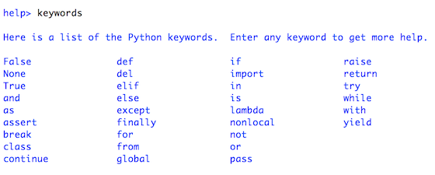
Python keywords are the words that are reserved. That means you can’t use them as name of any entities like variables, classes and functions.
So you might be thinking what are these keywords for. They are for defining the syntax and structures of Python language.
There are 33 keywords in Python programming language. Also keywords in Python is case sensitive. So they are to be written as it is. Here is a list of all keywords in python programming.

Slide 12
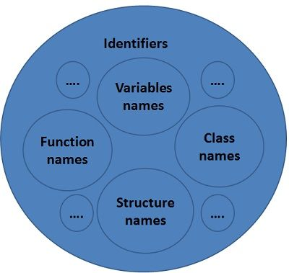
Difference Between Identifier and Variable

Slide 13
The word ‘identifier’ clearly defines itself; an identifier is a name given to an entity, which distinctly identifies an entity in a program at the time of its execution. Variable is also an identifier; its name uniquely identifies itself in a program.
Here, the fundamental difference between an identifier and variable is that an identifier is a “name given to entity” in a program whereas, a variable is a “name given to memory location”, that is used to hold value, which may get modified during program execution.
Furthermore, the name given to a variable, function, class, structure, that is in the source code of the program is an identifier. As against, a variable is a name associated with the memory cell whose value can be altered in a program. The number of characters can be more in the identifier as compared to a variable.

Slide 14
BASIS FOR COMPARISON | IDENTIFIER | VARIABLE
Use | Identifier is used to name a variable, function, class, structure, union etc. | Variable is used to name a memory location, which holds a value.
Purpose | Created to give a unique name to an entity. | Allots a unique name to a particular memory location.
Range | All identifiers are not variable. | All variables names are identifier.
Example | int a; or int a(){ // } | int a; or float a; //

Slide 15
Python Identifiers
Python Identifier is the name we give to identify a variable, function, class, module or other object. That means whenever we want to give an entity a name, that’s called identifier.
Sometimes variable and identifier are often misunderstood as same but they are not. Well for clarity, let’s see what is a variable?
Variable in Python
A variable, as the name indicates is something whose value is changeable over time. In fact a variable is a memory location where a value can be stored. Later we can retrieve the value to use. But for doing it we need to give a nickname to that memory location so that we can refer to it. That’s identifier, the nickname.
Rules for writing Identifiers
There are some rules for writing Identifiers. But first you must know Python is case sensitive. That means Name and name are two different identifiers in Python. Here are some rules for writing Identifiers in python.
Identifiers can be combination of uppercase and lowercase letters, digits or an underscore(_). So myVariable, variable_1, variable_for_print all are valid python identifiers.

Slide 16
An Identifier can not start with digit. So while variable1 is valid, 1variable is not valid.
We can’t use special symbols like !,#,@,%,$ etc in our Identifier.
Identifier can be of any length.
Though these are hard rules for writing identifiers, also there are some naming conventions which are not mandatory but rather good practices to follow.
Class names start with an uppercase letter. All other identifiers start with a lowercase letter.
Starting an identifier with a single leading underscore indicates the identifier is private.
If the identifier starts and ends with two underscores, than means the identifier is language-defined special name.
While c = 10 is valid, writing count = 10 would make more sense and it would be easier to figure out what it does even when you look at your code after a long time.
Multiple words can be separated using an underscore, for example this_is_a_variable.

Slide 17
myVariable="hello world"
print(myVariable)
var1=1
print(var1)
var2=2
print(var2)
var = 1;
if(var==1):
print("odd")
else:
print("even")

Slide 18
Statement, Indentation in Python
Statements
Instructions written in the source code for execution are called statements. There are different types of statements in the Python programming language like Assignment statement, Conditional statement, Looping statements etc. These all help the user to get the required output. For example, n = 50 is an assignment statement.
Multi-Line Statements: Statements in Python can be extended to one or more lines using parentheses (), braces {}, square brackets [], semi-colon (;), continuation character slash (\). When the programmer needs to do long calculations and cannot fit his statements into one line, one can make use of these characters.

Slide 19
Declared using Continuation Character (\):
s=1+2+3\
+4+5+6\
+7+8
print(s)
Declared using parentheses ():
N=(1*2*3+4+5+6)
print(N)
Declared using square brackets []:
Footballer=[‘Messi’,’Neymar’,’Ronaldo’]
print(Footballer)
Declared using braces {}:
X={1+2+3+4+5}
print (x)
Declared using semicolon(;) :
Flag=3;ropes=4;pole=5

Slide 20
Indentation
A block is a combination of all these statements. Block can be regarded as the grouping of statements for a specific purpose. Most of the programming languages like C, C++, Java use braces { } to define a block of code. One of the distinctive features of Python is its use of indentation to highlight the blocks of code. Whitespace is used for indentation in Python. All statements with the same distance to the right belong to the same block of code. If a block has to be more deeply nested, it is simply indented further to the right. You can understand it better by looking at the following lines of code:
var=2
if((var%2)!=0):
print("odd")
else:
print("even")
print("number")
print("out of the block")

Slide 21
Comments
Python developers often make use of the comment system as, without the use of it, things can get real confusing, real fast. Comments are the useful information that the developers provide to make the reader understand the source code. It explains the logic or a part of it used in the code. Comments are usually helpful to someone maintaining or enhancing your code when you are no longer around to answer questions about it. These are often cited as a useful programming convention that does not take part in the output of the program but improves the readability of the whole program. There are two types of comment in Python: Single line comments : Python single line comment starts with hashtag symbol with no white spaces (#) and lasts till the end of the line. If the comment exceeds one line then put a hashtag on the next line and continue the comment. Python’s single line comments are proved useful for supplying short explanations for variables, function declarations, and expressions.
#myVariable="hello world"
#print(myVariable)

Slide 22
Multi-line string as comment : Python multi-line comment is a piece of text enclosed in a delimiter (""") on each end of the comment. Again there should be no white space between delimiter (""").
They are useful when the comment text does not fit into one line; therefore needs to span across lines.
Multi-line comments or paragraphs serve as documentation for others reading your code.
See the following code snippet demonstrating multi-line comment:
"""
if((var%2)!=0):
print("odd") """
'''
else:
print("even")
print("number")
print("out of the block")'''

Slide 23
Each value in Python is called an object. Each object is of a particular type. There are several data types in Python. These include integer (called int in Python), float, boolean (called bool in Python), string (called str in Python), list, tuple, set, dictionary (called dict in Python), and None.
Everything in Python is an object. And what every newcomer to Python should quickly learn is that all objects in Python can be either mutable or immutable.
Since everything in Python is an Object, every variable holds an object instance. When an object is initiated, it is assigned a unique object id. Its type is defined at runtime and once set can never change, however its state can be changed if it is mutable. Simply put, a mutable object can be changed after it is created, and an immutable object can’t.
Objects of built-in types like (int, float, bool, str, tuple, unicode) are immutable. Objects of built-in types like (list, set, dict) are mutable. Custom classes are generally mutable. To simulate immutability in a class, one should override attribute setting and deletion to raise exceptions.

Slide 24
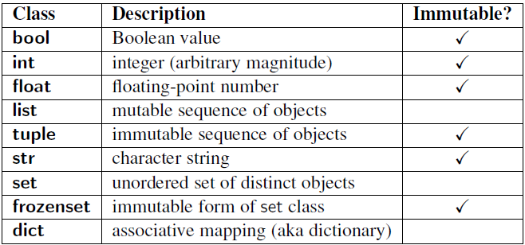

Slide 25
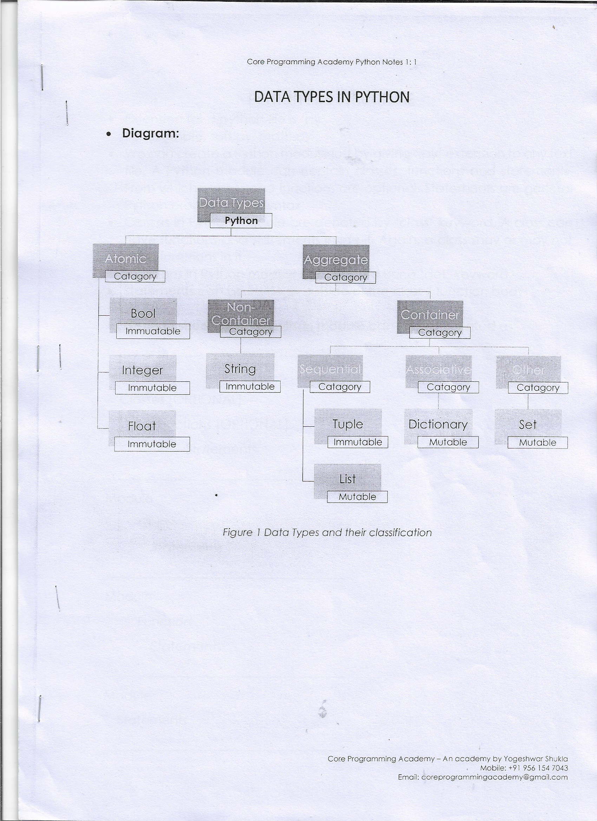

Slide 26
Now comes the question, how do we find out if our variable is a mutable or immutable object. For this we should understand what ‘ID’ and ‘TYPE’ functions are for.
ID and TYPE
The built-in function id() returns the identity of an object as an integer. This integer usually corresponds to the object’s location in memory, although this is specific to the Python implementation and the platform being used. The is operator compares the identity of two objects.
The built-in function type() returns the type of an object.

Slide 27
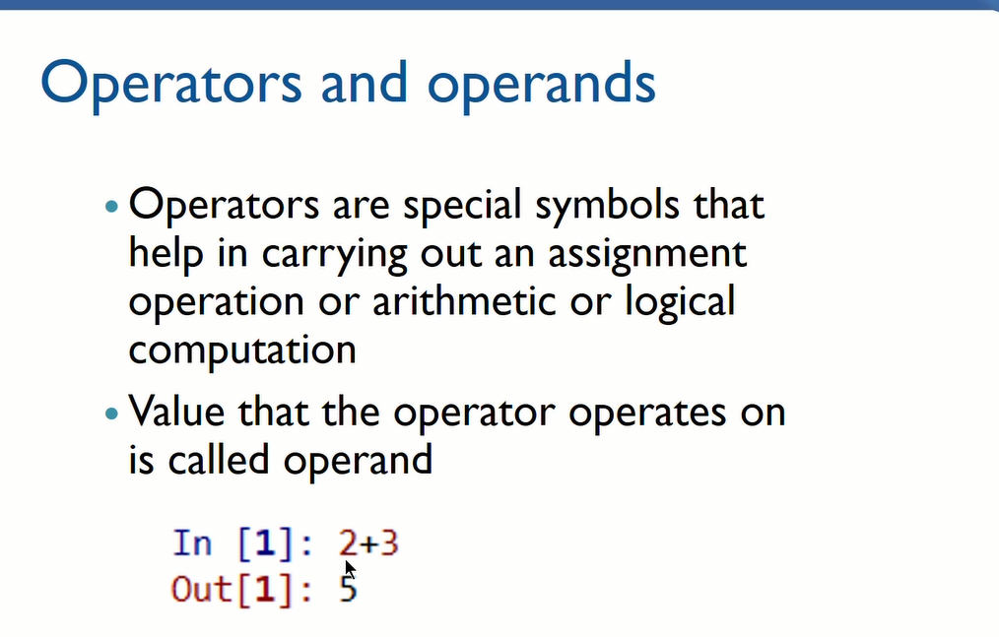

Slide 28
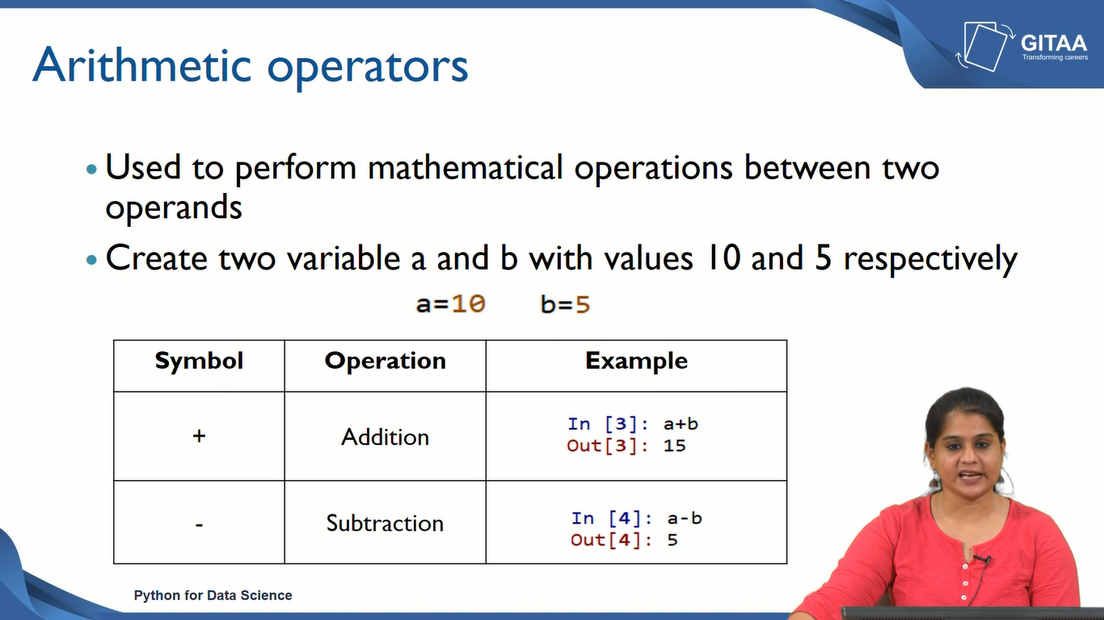
Arithmetic Operators

Slide 29
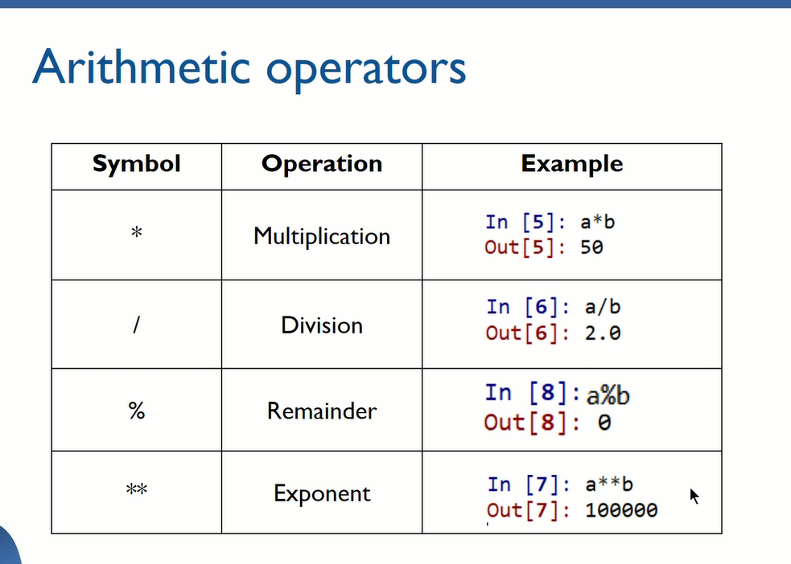

Slide 30
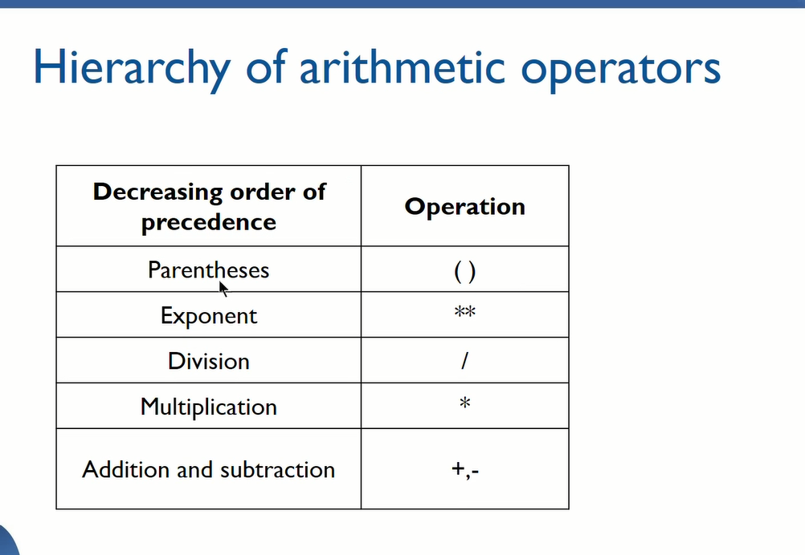

Slide 31
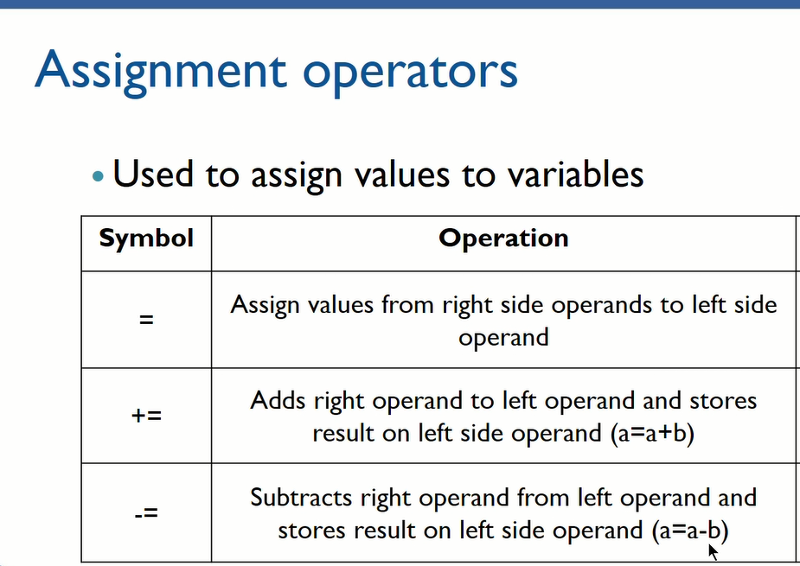

Slide 32
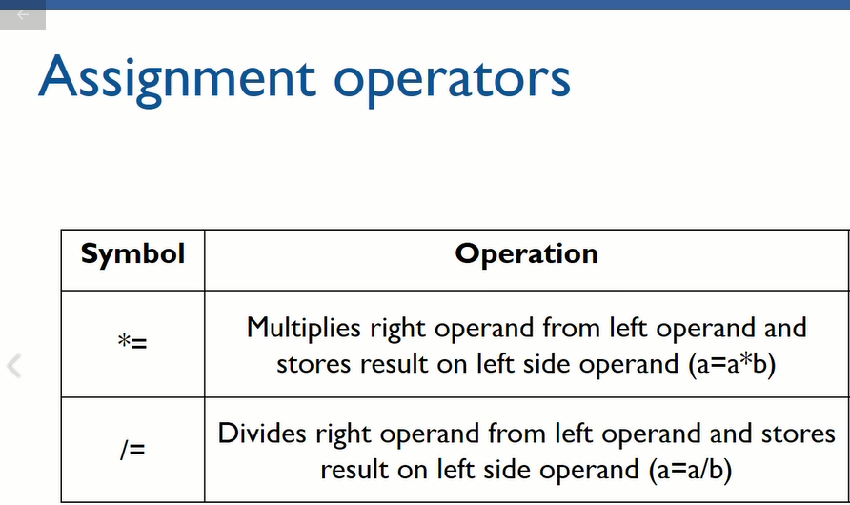

Slide 33
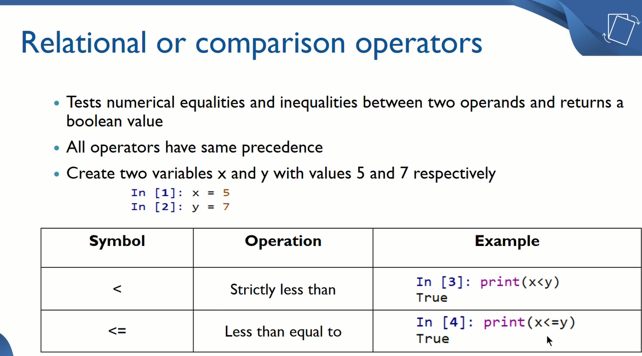

Slide 34
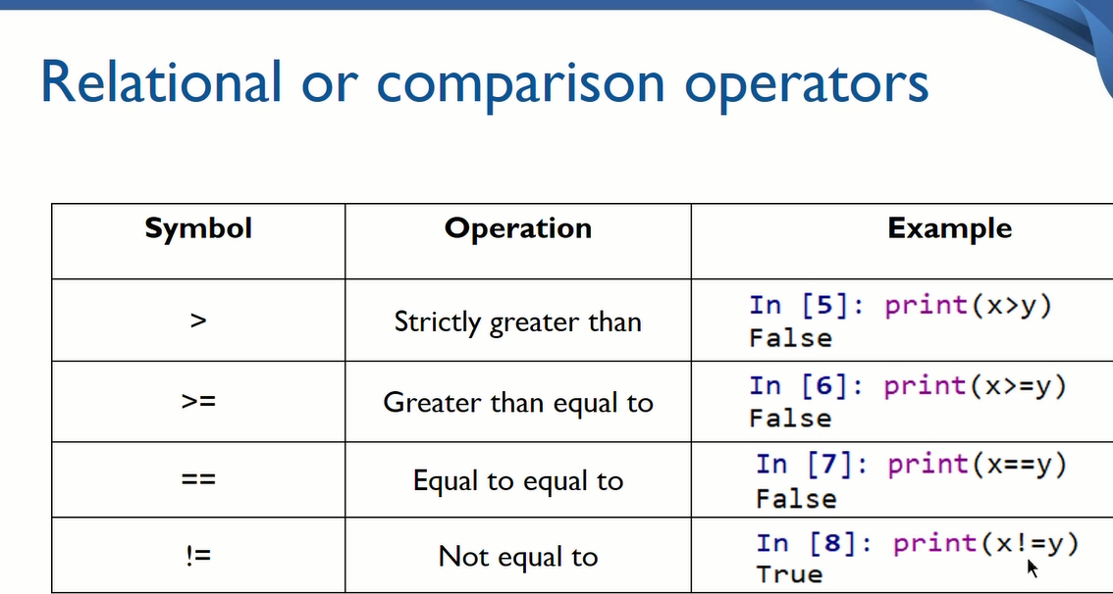

Slide 35
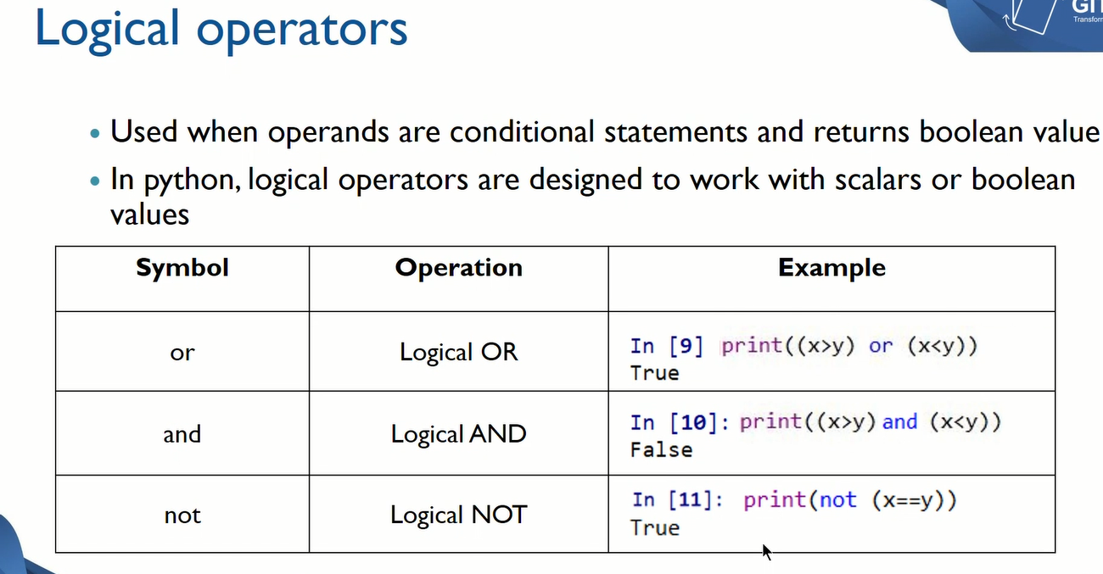

Slide 36
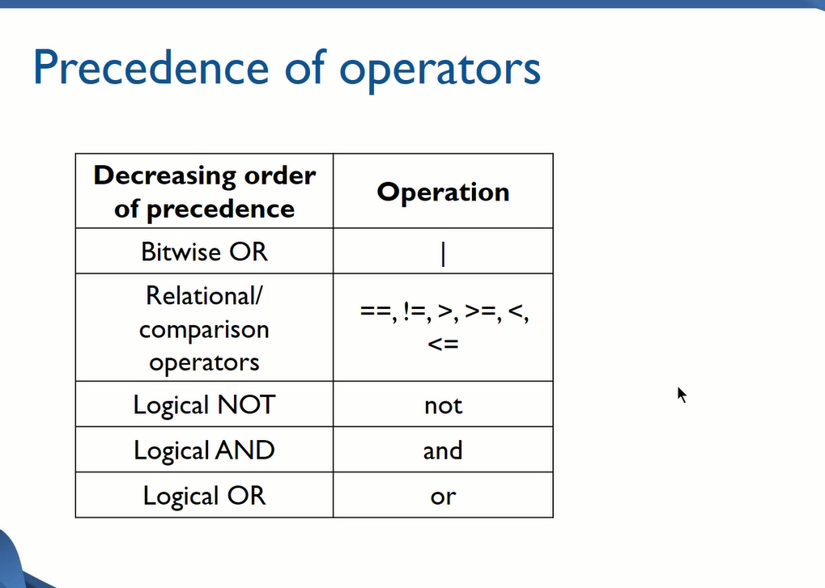

Slide 37
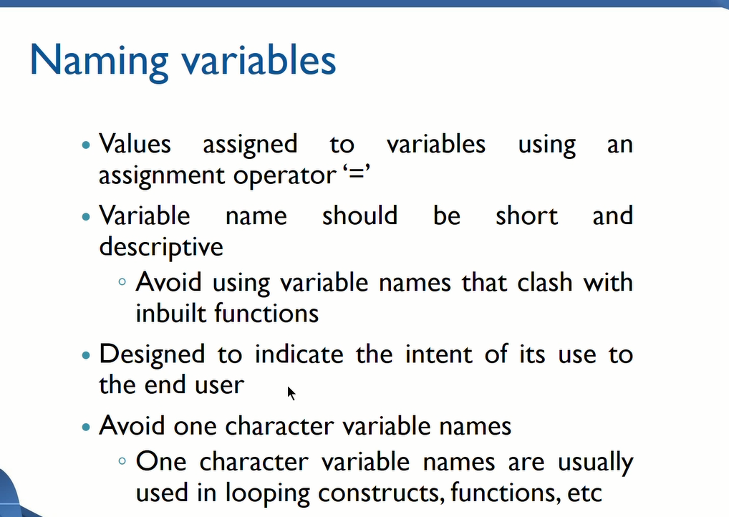

Slide 38
Naming Variables
Variables can be named alphanumerically
Age=55, age=55, age2=55, Age2=55
However the first letter should start with an alphabet.
Other special characters
Underscore(_) emp_id=101
Use of any other special character will throw an error emp@id=101
Variable names should not begin or end with underscore _empid=101
Empid_=101

Slide 39
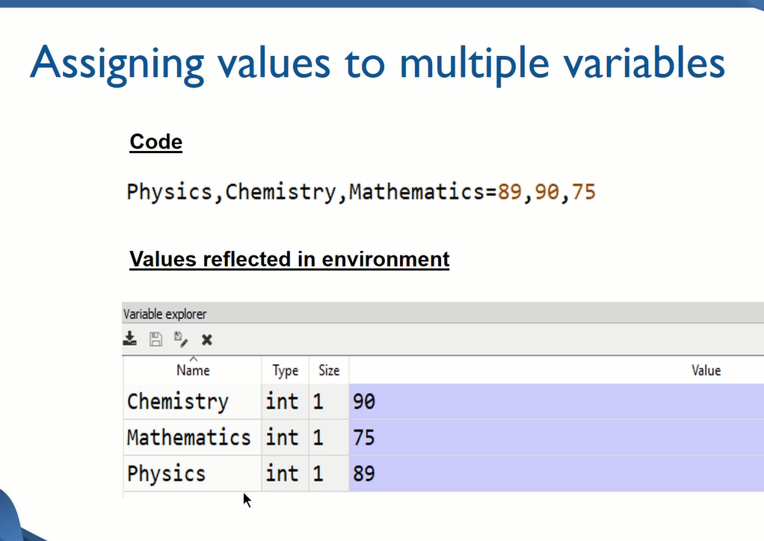

Slide 40
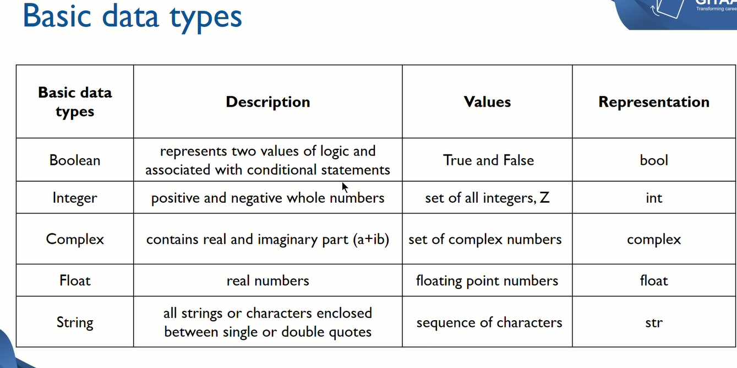

Slide 41
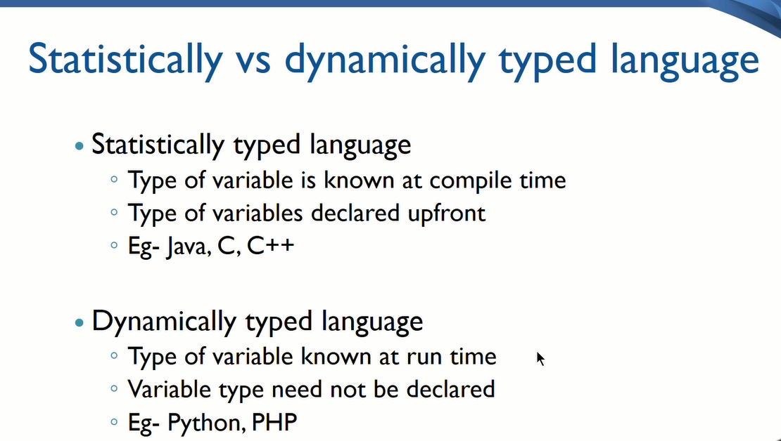

Slide 42
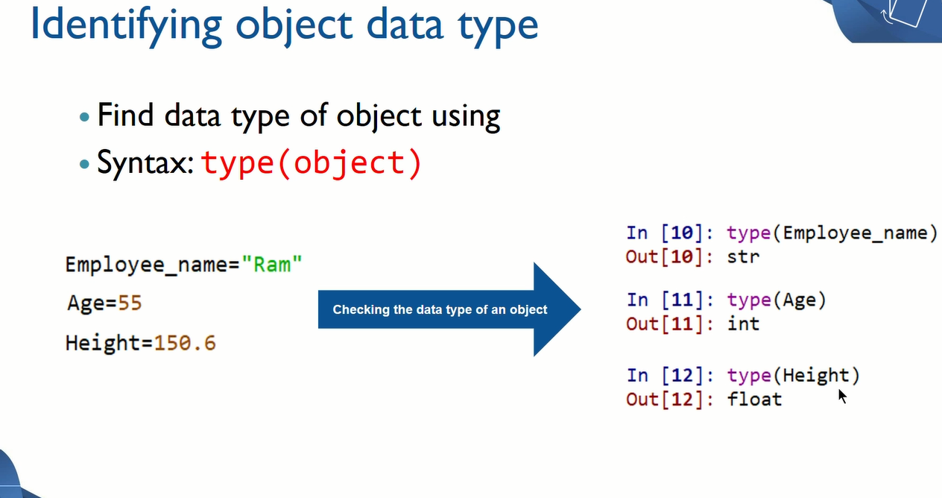

Slide 43
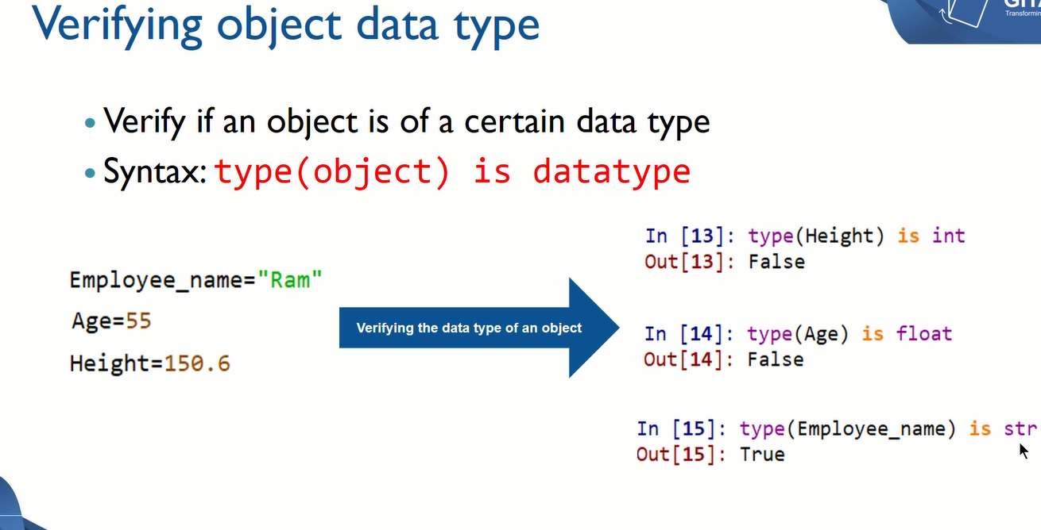

Slide 44
Coercing Object to new datatype
Convert datatype of an object to another
Syntax – datatype(object)
Changes can be stored in same variable or different variable

Slide 45
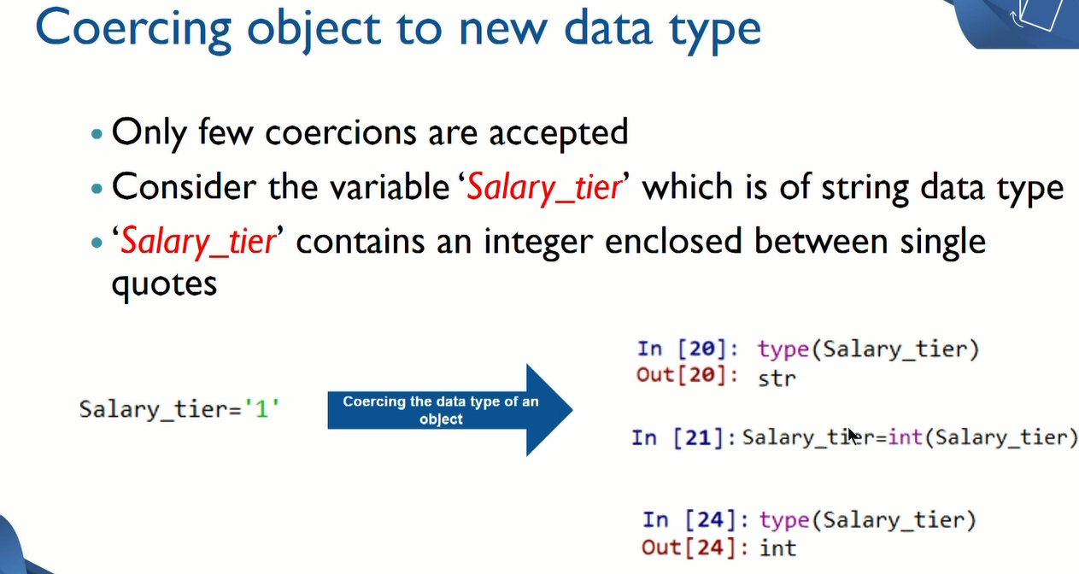

Slide 46
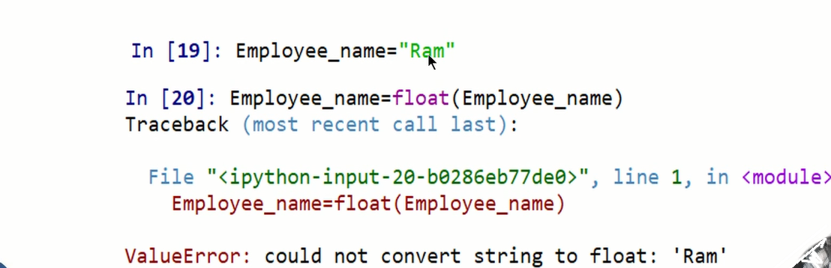
However if the value enclosed within the quotes is a String then conversions will not be possible

Slide 47
You might face a situation in which you need to exit a loop completely when an external condition is triggered or there may also be a situation when you want to skip a part of the loop and start next execution.
Python provides break and continue statements to handle such situations and to have good control on your loop.
The break Statement:
The break statement in Python terminates the current loop and resumes execution at the next statement, just like the traditional break found in C.
The most common use for break is when some external condition is triggered requiring a hasty exit from a loop. The break statement can be used in both while and for loops.

Slide 48
for letter in 'Python': # First Example
if letter == 'h':
break
print('Current Letter :', letter)
var = 10 # Second Example
while var > 0:
print('Current variable value :', var)
var = var -1
if var == 5:
break
Print("Good bye!“)

Slide 49
This will produce the following result:
Current Letter : P
Current Letter : y
Current Letter : t
Current variable value : 10
Current variable value : 9
Current variable value : 8
Current variable value : 7
Current variable value : 6
Good bye!

Slide 50
The continue Statement:
The continue statement in Python returns the control to the beginning of the while loop. The continue statement rejects all the remaining statements in the current iteration of the loop and moves the control back to the top of the loop.
The continue statement can be used in both while and for loops.
for letter in 'Python': # First Example
if letter == 'h':
continue
print 'Current Letter :', letter
var = 10 # Second Example
while var > 0:
var = var -1
if var == 5:
continue
print 'Current variable value :', var
print "Good bye!"

Slide 51
This will produce following result:
Current Letter : P
Current Letter : y
Current Letter : t
Current Letter : o
Current Letter : n
Current variable value : 10
Current variable value : 9
Current variable value : 8
Current variable value : 7
Current variable value : 6
Current variable value : 4
Current variable value : 3
Current variable value : 2
Current variable value : 1
Good bye!

Slide 52
The else Statement Used with Loops
Python supports to have an else statement associated with a loop statements.
If the else statement is used with a for loop, the else statement is executed when the loop has exhausted iterating the list.
If the else statement is used with a while loop, the else statement is executed when the condition becomes false.
Example:
The following example illustrates the combination of an else statement with a for statement that searches for prime numbers from 10 through 20.

Slide 53
for num in range(10,20): #to iterate between 10 to 20
for i in range(2,num): #to iterate on the factors of the number
if num%i == 0: #to determine the first factor
j=num/i #to calculate the second factor
print '%d equals %d * %d' % (num,i,j)
break #to move to the next number, the #first FOR
else: # else part of the loop
print num, 'is a prime number'

Slide 54
This will produce following result:
10 equals 2 * 5
11 is a prime number
12 equals 2 * 6
13 is a prime number
14 equals 2 * 7
15 equals 3 * 5
16 equals 2 * 8
17 is a prime number
18 equals 2 * 9
19 is a prime number

Slide 55
The pass Statement:
The pass statement in Python is used when a statement is required syntactically but you do not want any command or code to execute.
The pass statement is a null operation or simply No Operation(NOP) statement; nothing happens when it executes. The pass is also useful in places where your code will eventually go, but has not been written yet (e.g., in stubs for example):
for letter in 'Python':
if letter == 'h':
pass
print 'This is pass block'
print 'Current Letter :', letter
print "Good bye!"

Slide 56
This will produce following result:
Current Letter : P
Current Letter : y
Current Letter : t
This is pass block
Current Letter : h
Current Letter : o
Current Letter : n
Good bye!

Slide 57
The pass statement is used as a placeholder. Ex – if we have a loop that is not implemented yet, but we may wish to write some code in it in the future. In such cases, pass statement can be written because we cannot have an empty body of the loop. Though the pass statement will not do anything, but it will make the program syntactically correct.
for i in range(10,20):
Will show an error as the loop does not show any code. Hence writing pass will remove the error
Difference between comment and pass statements –
In Python programming, pass is a null statement. While the interpreter ignores a comment, pass is not. Comment is not executed but pass statement is executed but nothing happens.
Difference between break, continue, pass
The break statement terminates the execution of the nearest enclosing loop in which it appears.
The continue statement skips the rest of the statements in the loop and transfers the control unconditionally to the loop-continuation portion of the nearest enclosing loop.
The pass statement is a do-nothing statement in a loop. It is just added to make the loop syntactically correct. That is, pass statement is written as we cannot have an empty body of the loop

